Slide 1
Javascript Regular Expressions And HTML Forms
IN712 Web 3

Slide 2
Javascript Regular Expressions
Regular expressions provide a means of defining a pattern of characters, which you can then use to split, search for, or replace characters in a string when they fit the defined pattern
Regular expressions in JavaScript are used through the RegExp object

Slide 3
Javascript Regular Expressions
You have two ways of creating a new RegExp object
  var myRegExp = /\b'|'\b/;
  var myRegExp = new RegExp("\\b'|'\\b");
The main reason for using the second method is that it allows the regular expression to be determined at run time
  as the code is executing and not when you are writing the code
  This is useful if, for example, you want to base the regular expression on user input

Slide 4
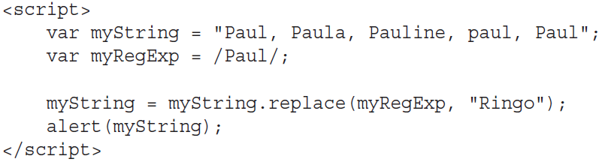
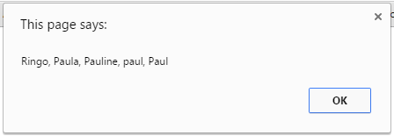
Regular expression example
By default, the RegExp object looks only for the first matching pattern, in this case the first Paul, and then
stops.

Slide 5
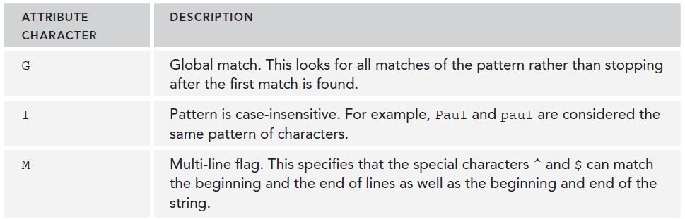
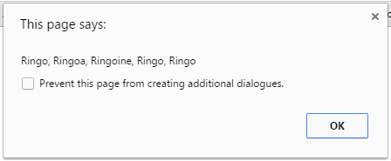

Attribute Characters

Slide 6
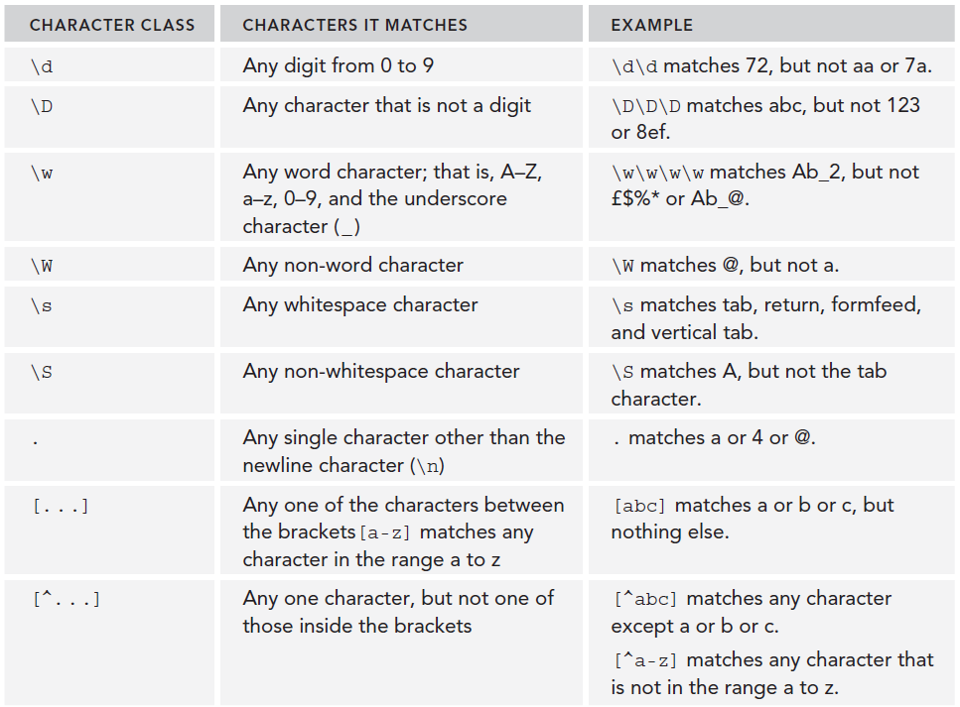
Regular expressions special characters

Slide 7
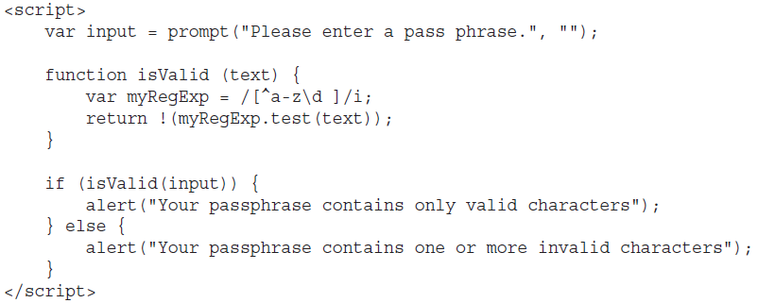
Example

Slide 8
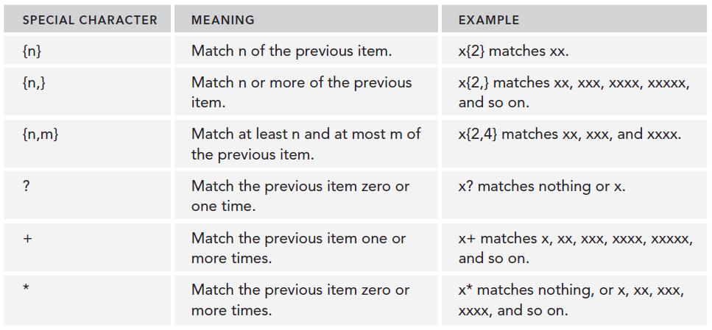
Repetition characters

Slide 9
Example: matching a telephone number
match a telephone number in the format 1‐800‐888‐5474
var myRegExp = /\d‐\d\d\d‐\d\d\d‐\d\d\d\d/
var myRegExp = /\d-\d{3}-\d{3}-\d{4}/

Slide 10
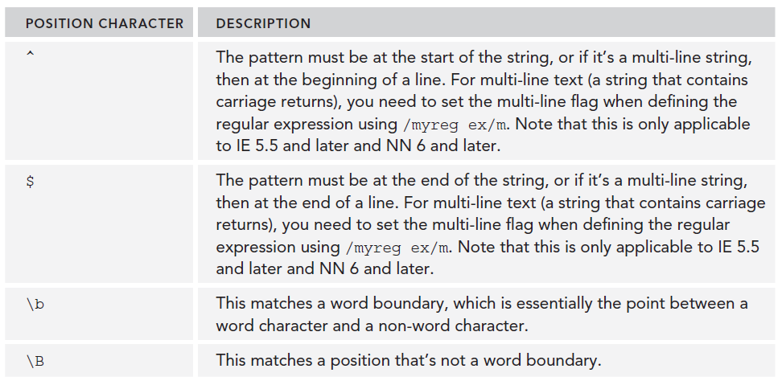
Position characters

Slide 11

Word Boundaries

Slide 12
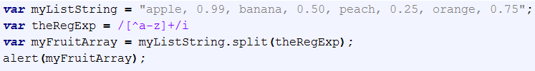
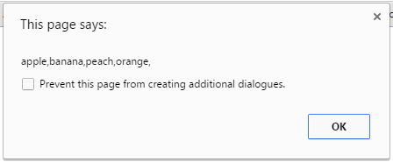
The String split() method
A String method that uses a regular expression or a fixed string to break a string into an array of substrings.

Slide 13
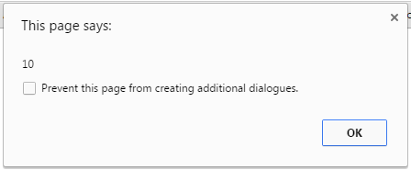
The String search() method
A String method that tests for a match in a string. It returns the index of the match, or -1 if the search fails.

Slide 14

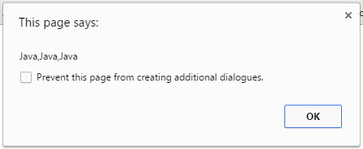
The String match() method
A String method that executes a search for a match in a string. It returns an array of information or null on a mismatch.

Slide 15
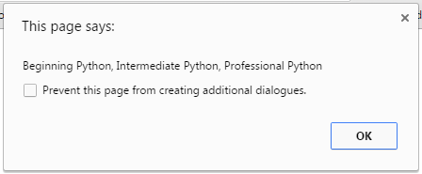
The String replace() method
A String method that executes a search for a match in a string, and replaces the matched substring with a replacement substring.

Slide 16

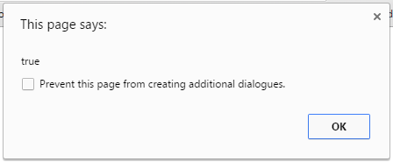
The RegExp test() method
A RegExp method that tests for a match in a string. It returns true or false.

Slide 17
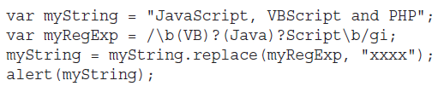
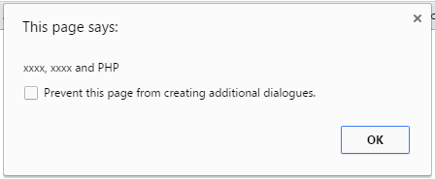
Grouping regular expressions
A word boundary: \b
Zero or one instance of VB: (VB)?
Zero or one instance of Java: (Java)?
The characters Script: Script
A word boundary: \b

Slide 18

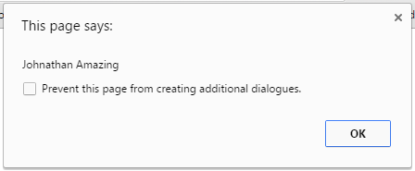
Reusing groups of characters

Slide 20
HTML Forms
Forms provide you with a way of grouping together HTML interaction elements with a common purpose
For example, a form may contain elements that enable the input of a user’s data for registering on a website
To create a form, use the <form> and </form> tags to declare where it starts and where it ends.
the action attribute determines where the form is submitted
the method attribute determines how the information is submitted
the target attribute determines the frame to which the response to the
form is loaded.
Generally speaking, for client‐side scripting where you have no intention of submitting information to a server yet, these attributes are not necessary
the only attribute you need is the name attribute, so that you can reference the form

Slide 21
Form Elements

Slide 22
Common Properties and Methods of Form Elements
Name Property: common to all form elements.
  You can use the value of this property to reference that particular element in your script.
  If you are sending the information in the form to a server, the element’s name property is sent along with any value of the form element, so that the server knows what the value relates to
Value Property: returns the value of the element. For example, for a text box, the value property returns the text that the user entered in the text box.
Form Property: returns the Form object in which the element is contained.
Type property: returns the type of the element (for example, button or text).

Slide 23
Focus() and blur() Methods
All form element objects also have the focus() and blur() methods.
The user can set which element currently has the focus by clicking it or by using the Tab key to select it.
you as the programmer can also decide which element has the focus by using the form element’s object’s focus() method
If an element is the center of the focus, any key presses made by the user are passed directly to that element.
  For example, if a text box has focus, pressing keys will enter values into the text box.
  if a button has the focus, pressing the Enter key causes the button’s onclick event handler code to fire, just as if a user had clicked the button with his mouse.

Slide 24
Focus() and blur() Methods
Blur, which perhaps could be better called “lost focus,” is the opposite of focus. If you want to remove a form element from being the focus of the user’s attention, you can use the blur() method.
When used with a form element, the blur() method usually results in the focus shifting to the page containing the form.
In addition to the focus() and blur() methods, all the form element’s objects have the onfocus and onblur event handlers.
These are fired when an element gets or loses the focus, respectively, due to user action or the focus() and blur() methods.
The onblur event handler can be a good place to check the validity of data in the element that has just lost the focus.

Slide 25

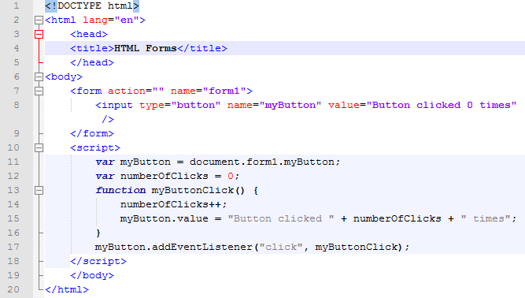
Example

Slide 26
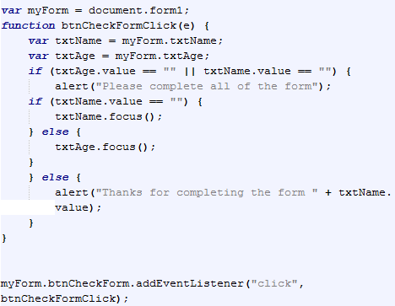
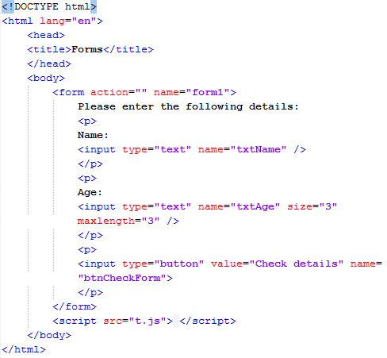
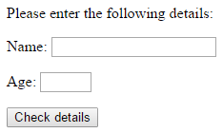
More Examples

Slide 27
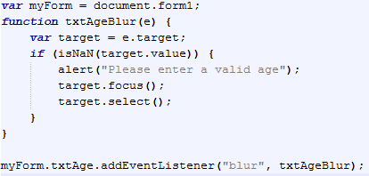
More Examples

Slide 28
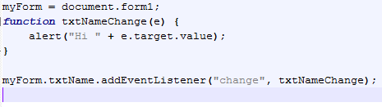
More Examples

Slide 29
Demo
http://liveweave.com/taPdRj

Slide 30
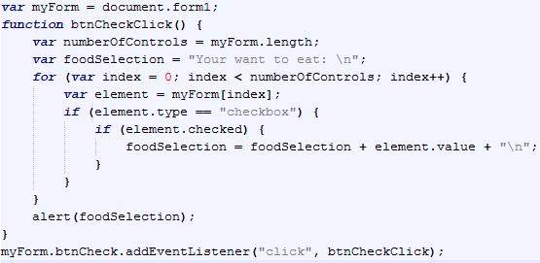
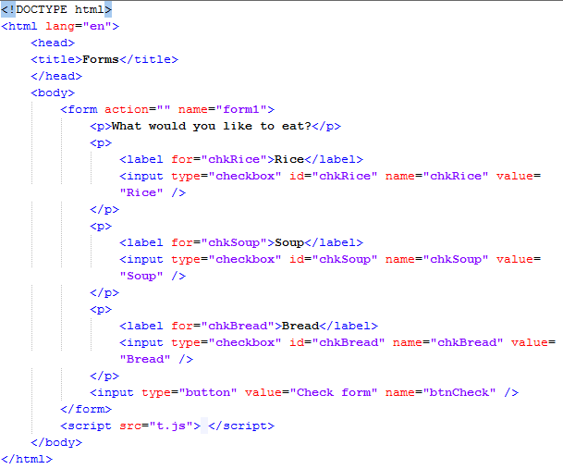
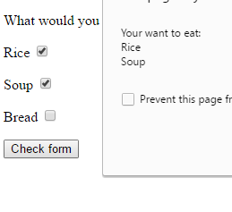
Check Boxes

Slide 31
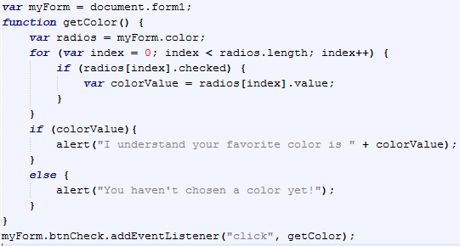
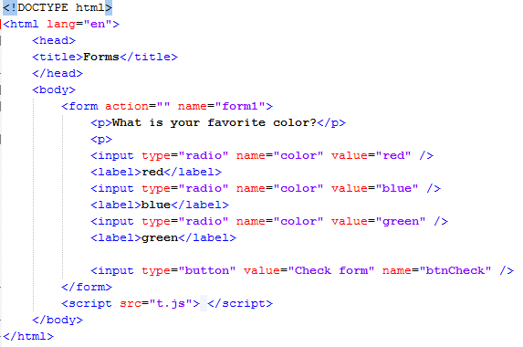
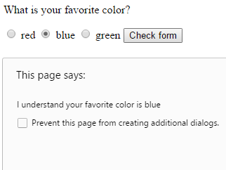
Radio Buttons

Slide 32
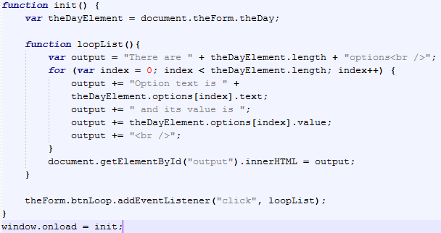
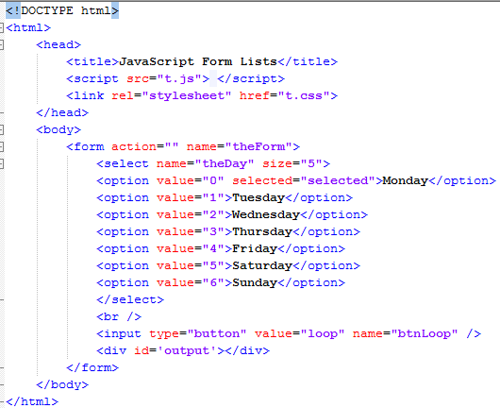
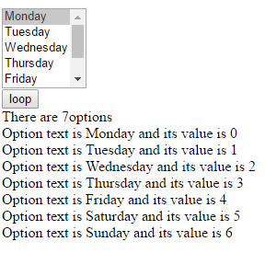
Lists

